Slide 1

Exploratory Data Analysis
G2M insight for Cab Investment firm
18th October 2024

Slide 2

Agenda
Executive Summary
Problem Statement
Approach
EDA
EDA Summary
Recommendations

Slide 3
Executive Summary
This analysis was conducted to help XYZ Company decide between investing in the Yellow or Pink cab company, using data on customer demographics, transactions, and city statistics.
We cleaned and linked the datasets, then performed exploratory data analysis (EDA) to explore relationships between customer traits, preferences, and the financial performance of each cab company.
The analysis revealed no significant connection between demographics and cab company choice, indicating customer preferences are independent of traits like age or income.
Financially, Yellow consistently outperformed Pink in average profit per trip, total trips, and overall profitability. Based on these insights, we recommend investing in the Yellow cab company for better returns.

Slide 4
Problem Statement
XYZ Company is evaluating two cab companies, Yellow and Pink, to determine which would be a better investment opportunity. The decision requires a data-driven analysis based on customer behavior, transaction records, and geographic information.
The objective of this analysis is to identify any trends or patterns that could influence the choice, including demographic preferences, financial performance, and overall profitability. By examining these factors, the goal is to make a clear recommendation on which company offers the most favorable investment prospects.

Slide 5
Approach
To guide XYZ Company’s investment decision, we followed a structured approach:
Data Cleaning: We started by checking for duplicates and missing values in the datasets in order to make the necessary corrections (non were needed).
Data Integration: We merged the datasets on common identifiers, such as transaction and customer IDs, to create a unified master dataset.
Feature Transformation: We converted key fields, like population and user counts, into numeric formats to facilitate analysis.
Exploratory Data Analysis (EDA): We analyzed customer demographics, company performance, and financial indicators to identify patterns and trends.
Insights and Recommendations: Based on the EDA, we derived actionable insights to recommend the most profitable investment option.

Slide 6
EDA
In the EDA we performed, we explored relations between variables that go beyond the interests of the XYZ Company as an investor. In this presentation we will only include those that are relevant for such purpose.
We begin by looking at the relation between demographic variables and each of the companies. Then we compare both companies in purely financial aspects.

Slide 7
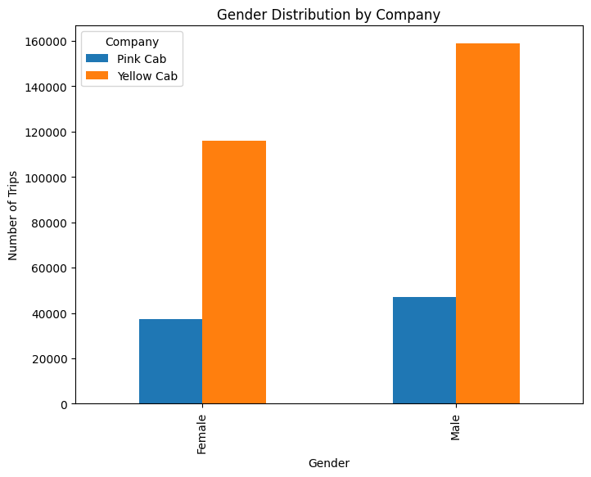
EDA

Slide 8
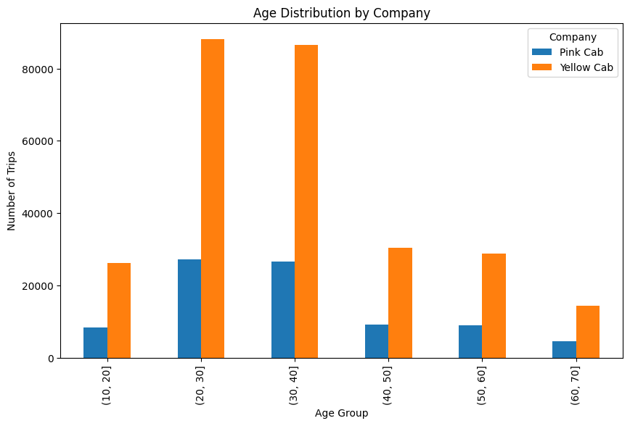
EDA

Slide 9
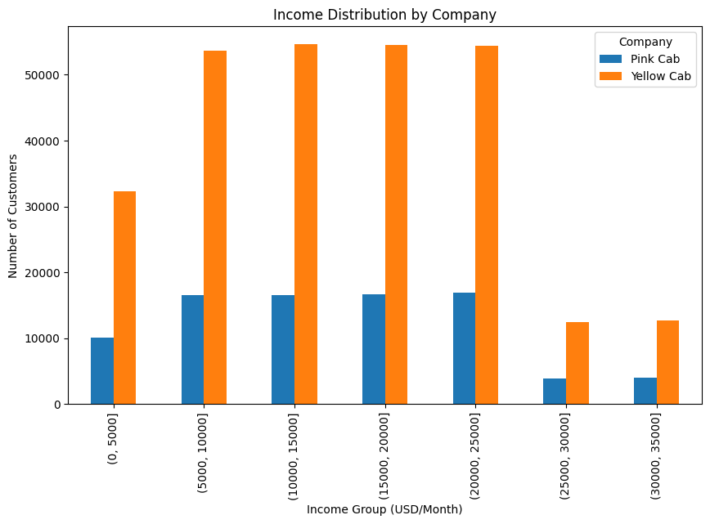
EDA

Slide 10
EDA
The previous histograms show that, based on the available data, there is no significant difference in the distribution of customers between the two companies with respect to age, income, or gender.
Therefore, the decision for investing into one or the other is not affected by any of this. No creative long-term investment plan can be done based on such differences .

Slide 11
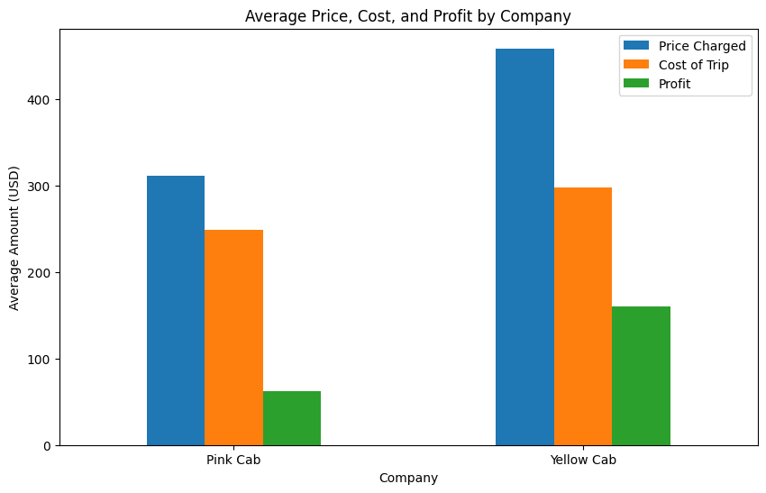
EDA

Slide 12
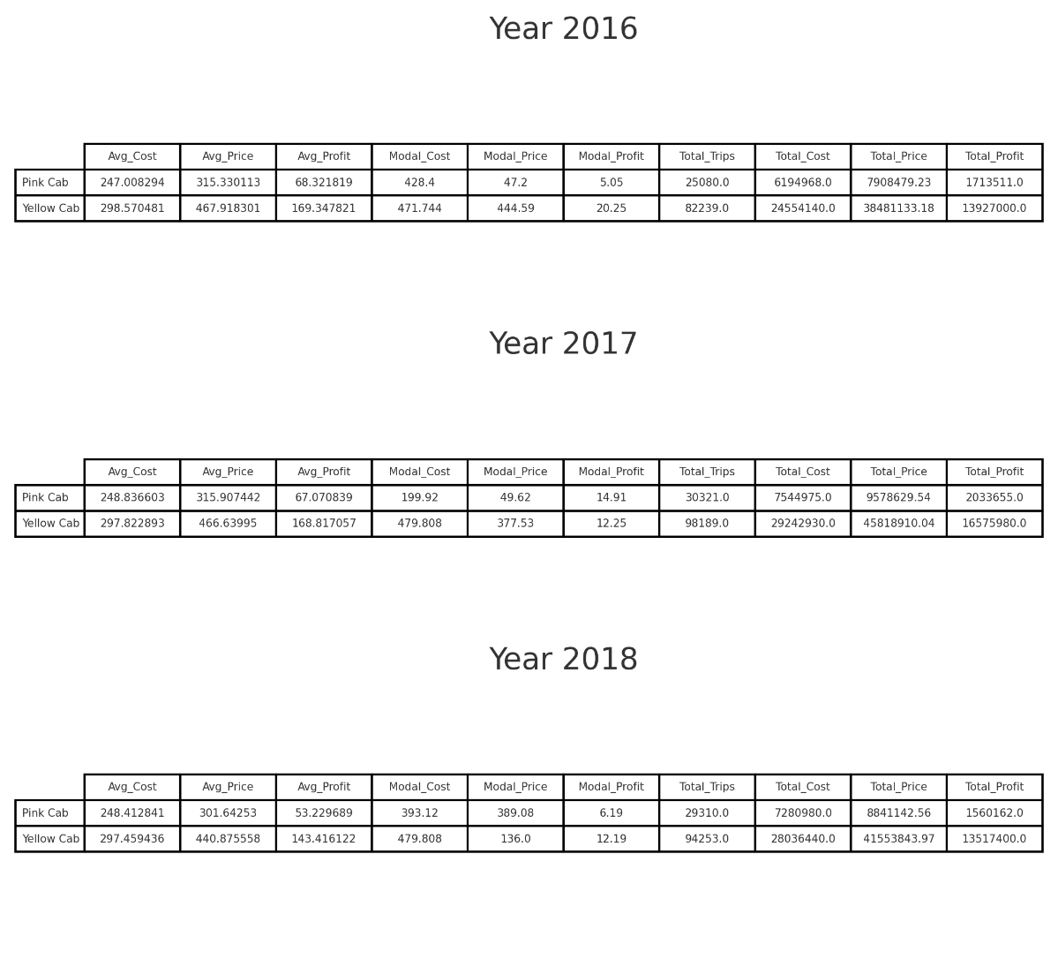
EDA

Slide 13
EDA
The financial analysis shows that Yellow Cab consistently outperforms Pink Cab in terms of both average profit per trip and total profit. Across the three years (2016-2018), Yellow Cab maintained significantly higher average profits, with figures such as $169.35 in 2016 compared to Pink Cab’s $68.32. This trend continued in 2017 and 2018, where Yellow Cab earned approximately double the average profit per trip compared to Pink Cab. Moreover, Yellow Cab consistently had a larger volume of trips, which contributed to its higher total profits—over $13 million each year compared to Pink Cab's much lower figures, ranging from $1.56 million to $2.03 million.
In addition to superior profits, Yellow Cab’s modal prices and profits further demonstrate its pricing strategy’s effectiveness. Yellow’s most frequent profit and price points were consistently higher than Pink’s, indicating stronger revenue generation per trip. Overall, the data suggests that Yellow Cab is not only more profitable but also more stable, making it a far better investment choice for XYZ Company.

Slide 14
EDA Summary
The exploratory data analysis (EDA) revealed no significant correlation between customer demographics (age, income, gender) and cab company preferences. Customers' choice between Yellow Cab and Pink Cab appeared to be independent of these factors, meaning that neither company had a specific appeal to different demographic groups. This finding suggests that marketing or investment strategies targeting specific customer traits would not be beneficial.
The financial analysis, however, highlighted clear differences between the two companies. Yellow Cab consistently outperformed Pink Cab across all key financial metrics, including average profit per trip, total trips, and total profit. This strong financial performance indicates that Yellow Cab is the more profitable and stable company, making it the superior investment choice.

Slide 15
Recommendations
Based on the analysis, it is strongly recommended that XYZ Company invest in Yellow Cab. The data clearly shows that Yellow Cab consistently outperforms Pink Cab in terms of average profit per trip, total number of trips, and overall profitability across multiple years. Yellow Cab’s stronger financial performance, coupled with its stability in both pricing and profit generation, makes it the superior choice for investment. Additionally, with no significant demographic differences influencing customer preference, Yellow Cab offers broader market appeal, further solidifying its potential for sustained growth and profitability.

